Slide 1
Identifying the Most Important Problems in Latin America – based on citizens’ perceptions
JUAN MARTINEZ

Slide 2
Purpose of the project
This project's aim is to explore what are the Latin American citizens' views on what constitutes the most important problems in their countries. Latin American countries, as any other country in the world, have their particular issues that citizens deal with and which affect their development. Because of plenty of characteristics shared by Latin American communities, groups of countries in the region have common problems. By identifying these problems, we can more accurately advice on the adequate policy interventions that would improve the conditions of living in each subregion of the study.
The results and conclusions of this work might be of interest specially to governments, policymakers, and other agents with the power to influence the destiny of each region in the study who are willing to make the contribution.

Slide 3
Introduction
Latin America is home to about 642 million citizens, conformed by countries that share plenty of characteristics: from the colonial past and later independence of most of them; the romance languages, mainly Spanish, except for Brazil, French Guiana and Suriname; similar economic practices, political history and religion; but also, the similarities extend to the problems and challenges that obstruct their development.
These shared characteristics make it possible to look at Latin America as a particular region where patterns repeat within its communities, and this study, by analyzing data on the problems people from the region face, attempts to identify the main problems in the region and define profiles for different subregions that will make it easier for governments and policymakers to determine where and how to act to improve the conditions in each subregion.

Slide 4
Objectives
Identify what are the most important problems Latin American citizens perceive in their respective countries.
Find patterns and define clusters for Latin American subregions based on the problems they share, which can make analysis of the conditions in the region easier and allow us to think about strategies to improve the living conditions of the subregions based on their specific problems.
Assess how the problems reported in each subregion relate to indicators that are relevant to measure the quality of governance, such as trust in the government and institutions and satisfaction with life.

Slide 5
Methodology
The goals of this project can be met by means of tools of data analysis. Specifically, the study will follow these steps:
Cleaning, processing, and analysis of the data to obtain information on what are the main problems people perceive in their countries, both at the country level and by subregions.
Develop the appropriate visualizations to make analysis of the data easier.
A KMeans algorithm will be employed to define clusters for each subregion in the study based on the problems people perceive as the most important.
Comparisons of clusters’ performance in certain indicators will be carried on through ANCOVA analysis and other analysis of the scores.

Slide 6
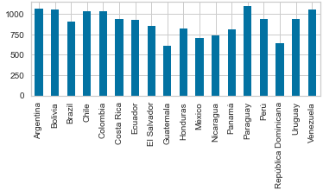
Specifications of the data
Source: All the data to analyze is obtained from the Latinobarometro survey of 2018, which gathers data on 20,204 Latin American citizens’ values, perceptions and opinions on a wide range of topics, of which most are relevant to their daily lives (https://www.latinobarometro.org/latContents.jsp).
Number of countries: 18
Number of subregions: 176 (only subregions with at least 30 responses)
Number of observations: 15,731
Observations by country:

Slide 7
Specifications of the data: variables for analysis
Most important problems by country: answers to the question “most important problem in your country.”
For ANCOVA analysis:
Dependent variables: Trust in the government, trust in the institutions (composite of trust in the government, trust in the police, trust in the congress and trust in the justice system) and satisfaction with life.
Covariates: Average education and average socioeconomic status by subregion.
Click here to see the problem_codebook to know which problem each observation refers to.
Check freely the dataset with all the values here.

Slide 8
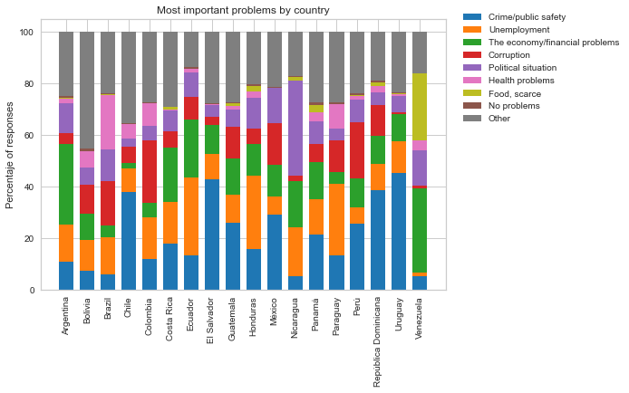
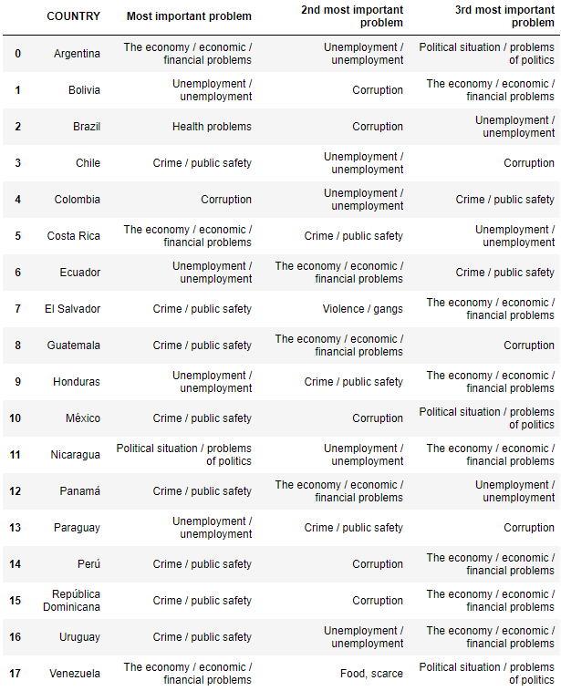
Main problems in Latin American countries – by country

Slide 9
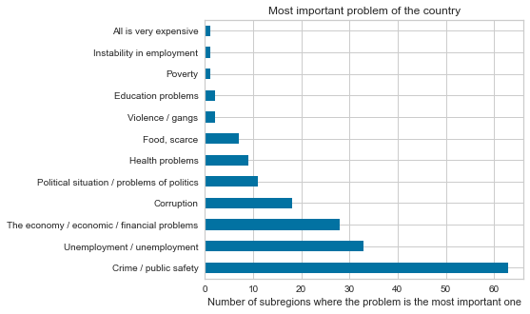
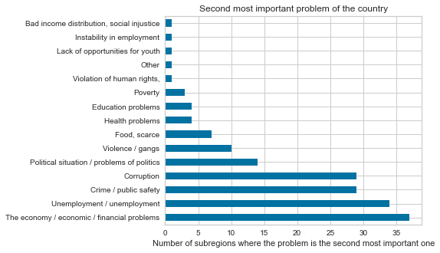
Main problems in Latin American countries – most common responses by subregion
In over a third of the 176 subnational regions citizens perceive crime or bad conditions of public safety is the most important problem, and it is the 2nd most important problem in 34 of the rest, making it a major problem in a large part of Latin America. Other important problems include unemployment, bad economic conditions, corruption and bad political situations.

Slide 10
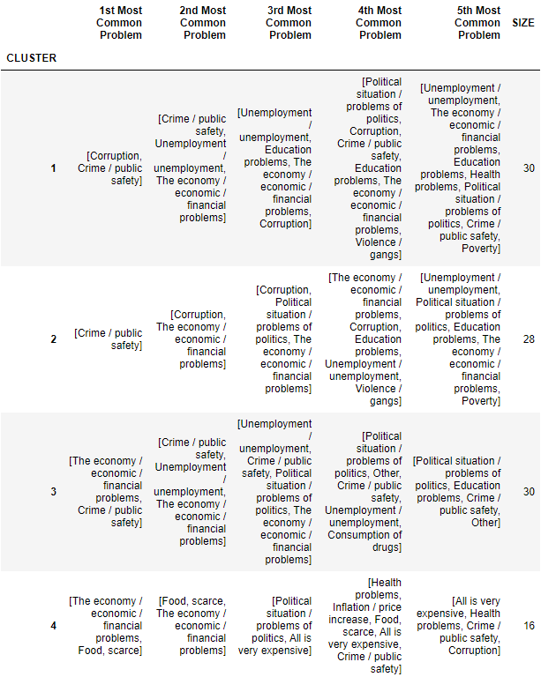
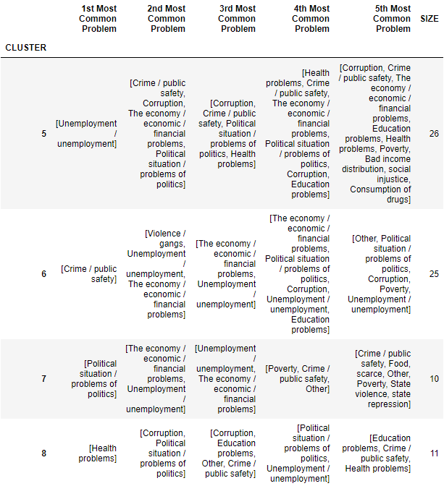
Defining clusters for subregions of Latin America – by most important problem in the country
This distinction of 8 clusters through a KMeans algorithm provides us with 8 different profiles of subregions in Latin America based on what citizens perceive are the main problems in their country.
Each cell shows the problems that make up for at least 80% of the problems reported in the category indicated. They are presented in descending order.
Some interesting takeaways from this data:
Crime is the most important problem in 2 clusters, but in one of them, the political situation often appears 2nd, while in the other it is violence/gangs.
Clusters 4, 7 and 8 seem to represent very special conditions. Only in the cluster 4 scarcity of food is one of the most important problems.

Slide 11
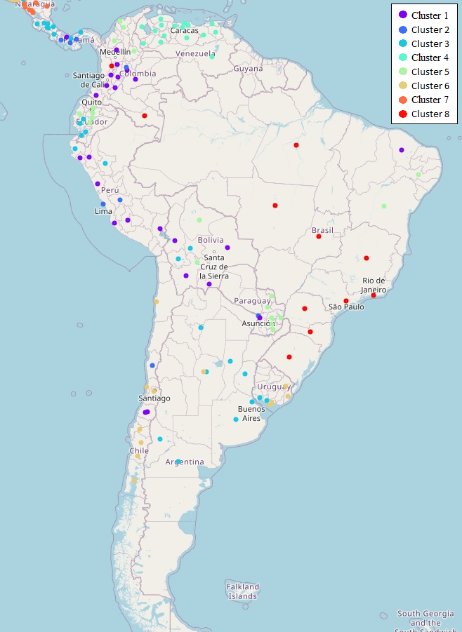
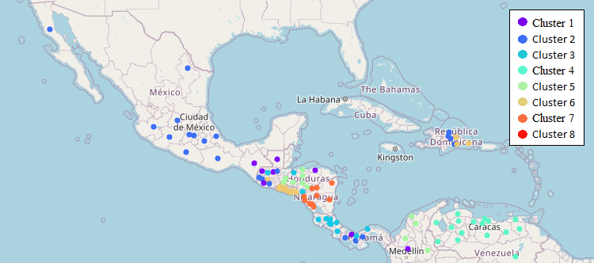
Geospatial visualization
Clusters seem to be concentrated in specific countries or in areas within countries. For example, cluster 4 is exclusive to Venezuela, and cluster 7 is exclusive to Nicaragua.
In other cases, clusters are concentrated in areas within the country, such as in Colombia, Ecuador, Mexico, and very likely in Dominican Republic. In Colombia, for instance, In Colombia, departments located in the Caribbean region are part of the cluster 5, while departments in the center and moving to the west are mostly part of the cluster 1

Slide 12
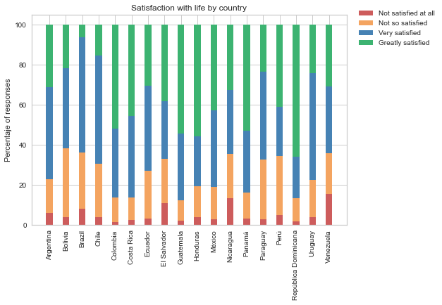
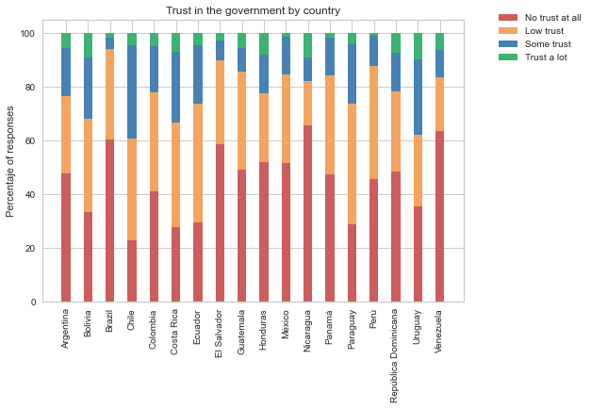
Levels of satisfaction with life and trust in the government by country
Levels of trust in the government across Latin America are quite low (over 60% of respondents report either low trust or no trust at all), which makes it harder for governments to get support to carry on their programs.
Despite this, levels of satisfaction with life seem quite decent (lower levels of either very satisfied or greatly satisfied are around 62% in countries such as Bolivia, Brazil, Nicaragua and Venezuela, while the highest are 85-90% in Colombia, Costa Rica, Guatemala, Panama, and Dominican Republic.

Slide 13
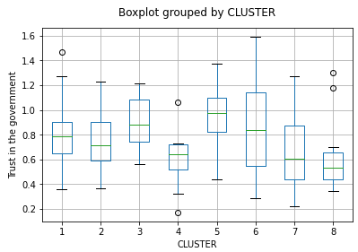
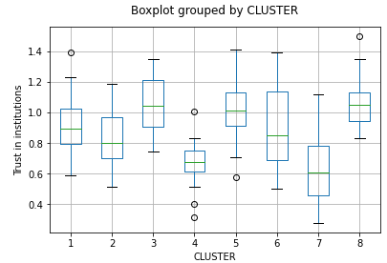
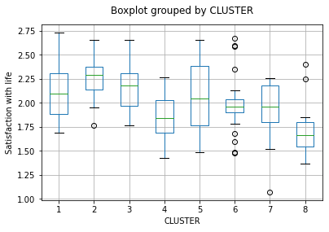



ANCOVA analysis - average level of education and average socioeconomic status as control variables
After controlling for the average level of education and the average socioeconomic status, we see that the levels of trust in the government and institutions and satisfaction with life vary significantly based on the series of problems in the subnational region, indicated by their cluster classifications.

Slide 14
Conclusion
As expected, similar to how there are many shared cultural, historic, and economic characteristics in Latin American social groups, there are also problems that are very common across the region.
That is the case, specially, of crime / public safety, which in 13 of the 18 countries of the study is among the top 3 most important problems, and in almost a third of the 176 subregions of the study is considered the most important problem, and the second most important problem in other 28 subregions. Other problems of great relevance in most Latin American countries were economic / financial problems and unemployment. For more specific cases but still very significant we find corruption and problems related to the political situation
There are also cases of countries with situations that are unique, where citizens in many of their subregions bring the attention to problems that are not so spread in other countries of the region. The clearest example is Venezuela, with problems of scarcity of food. Another case is Nicaragua with political problems as the most important.
ANCOVA analysis confirms that there are significant differences in levels of trust in the government, trust in the institutions and satisfaction with life for some subregions when classifying them based on their important problems. This is true for states of Venezuela in the three measures; departments for Nicaragua with respect to trust in the institutions; and for some states of Brazil, where health problems, corruption, and problems of politics are the most important problems.

